Slide 1
Core Java Introduction

Slide 2
Overview
About Java
what is Java?
what was the reason of creation?
What is JVM, JRE, JDK?
Features of Java
Evolution Of Java

Slide 3
About Java
• One of the most popular programming languages since 1996.
• Has around 10 million developers worldwide.
• Considered for small devices to enterprise applications.

Slide 4
What is Java?
• Developed as a high level programming language by Sun Microsystems in 1996. • Now a platform and development & runtime environment

Slide 5
What was the reason of creation?
• Needed a cross-platform language for multi-device development.
• C++ though object oriented and widely used was highly resource
intensive.
• Developed with aim of 'Write Once, Run Anywhere'.

Slide 6
Class loader

Slide 7
Features of Java
• Platform Independent
• Compiled and Interpreted
• Object Oriented
• Simple
• Robust & Secure
• Multithreaded
• Dynamic

Slide 8
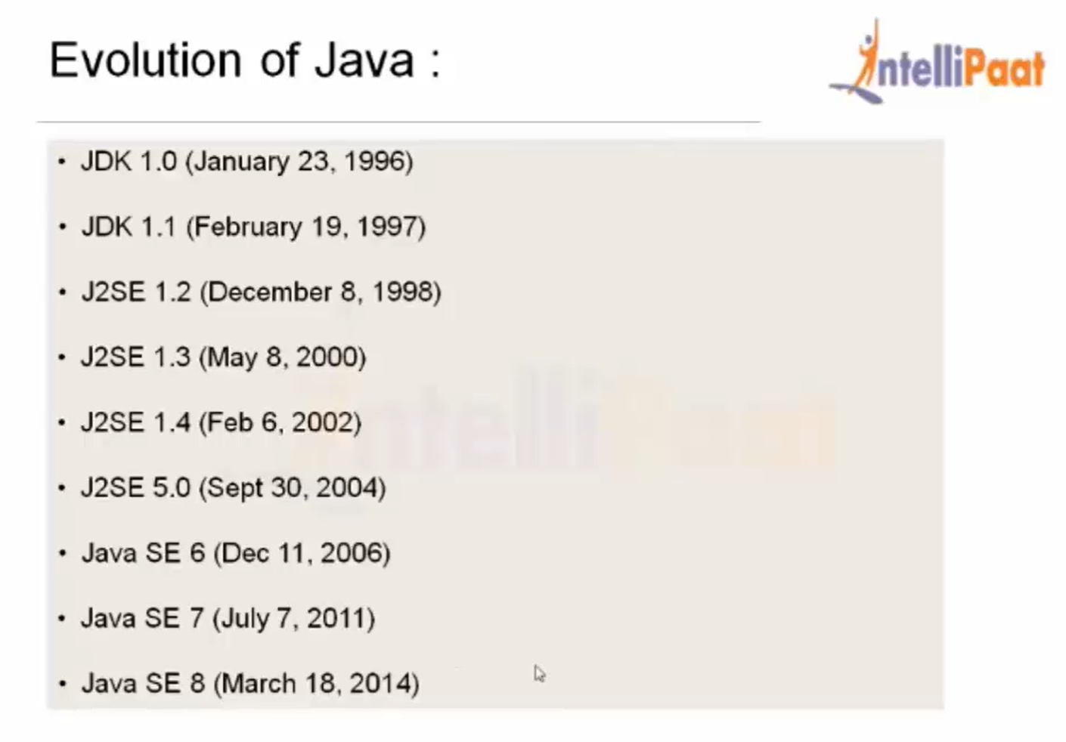

Slide 9


